Slide 1
Task 3 – Visual Thinking - Trailer

Slide 2
Possible ideas
Places where busy :
Strada Stretta (Valetta)
Fort Campbell (Mellieha)
Old homes (now Abandoned)
Notes:
Places that where busy, Strada Stretta (Valetta), Fort Campbell (Mellieha), Old homes (now Abandoned). These are places witch came to mind but fort Campbell with the compelling story won over.

Slide 3
The Idea
Long and informative shots
Empty shots (uncanny Feel)
Smooth Transitions no Cuts
Fort Campbell (Mellieħa)
Notes:
Long and informative shots with an empty feel to portray the uncanny feel but the place was a busy place a decade ago. No cuts but a smooth 30 second video.
Location Fort Campbell Mellieha Malta.

Slide 4
Visual Techniques
Mystery to the shot.
Framed using the rule of thirds.
Always trying to have an Easter egg.
Having the scene explain it’s slef.
It’s Beauiful
Notes:
Having mystery, something that isn’t explained but can be seen, no story how it came there its just there. Using the rule of thirds. Always have that one object witch is placed intentional. The scene will expain it’s self. Compostions with the rule of thirds the texture of the place will look beautiful.

Slide 5
Visual Techniques – Cont.
Leading lines
Visual cues to place
Always eye level
Notes:
Leading lines to what I will want the viewer to see. Cues to where you are at the place even if you haven't visited. Always a neutral feel not to high or to low of a shot rather at eye level.

Slide 6
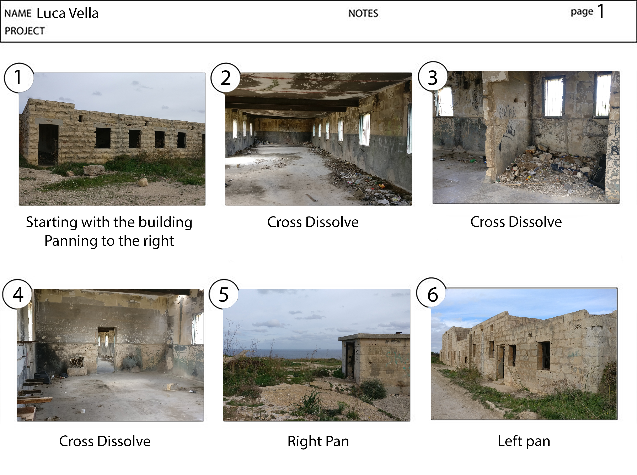

Slide 7
Storyboard 1
Getting the first feel of the place
Inside
Shapes and how the years have passed
The outside has degraded too.
Notes:
The first shot is getting the feel for the palce then moving on to the inside to seeing how it’s left by the elements and even people damaging the place when it’s already falling apart.
Back to the ouside a worse and worse shot of the place thinking people used to live here.

Slide 8
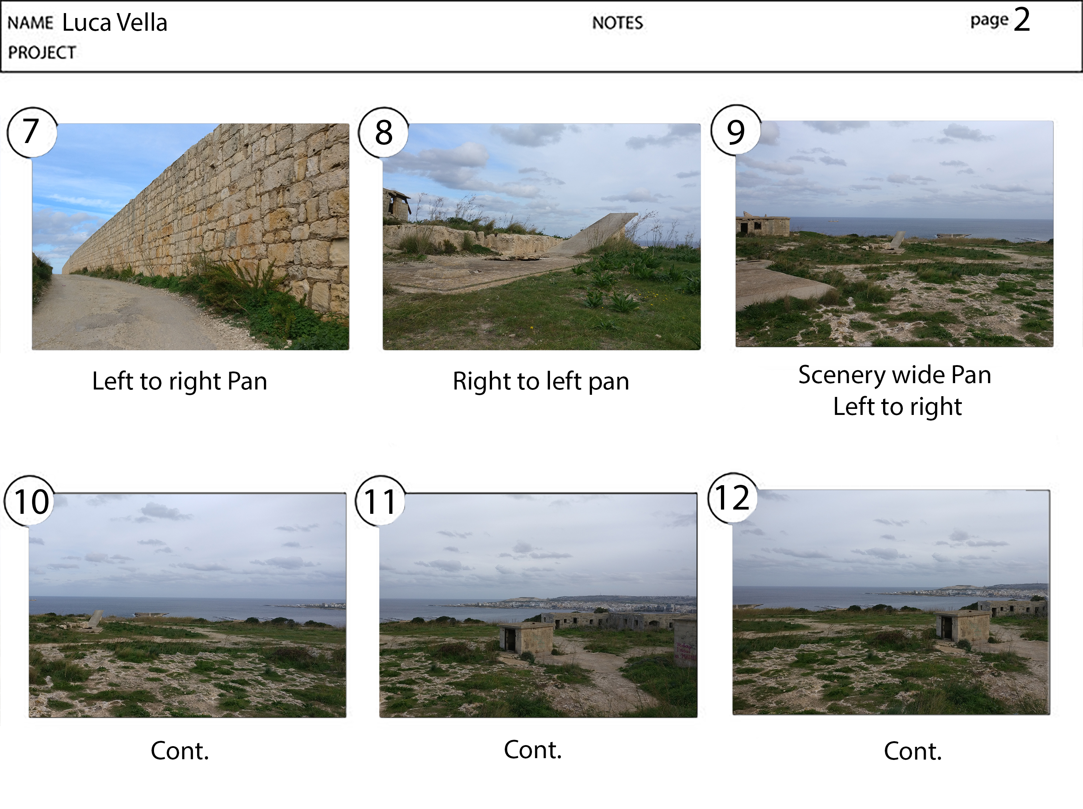

Slide 9
Storyboard 2
Leading to what?
Degraded
A beautiful view to contrast the state of the place
Notes:
Leading lines to the infinite, the random holes in the ground.
To finish with a contrast of a nice view of the ocean one can still see whilst underneeth the old uncanny place.

Slide 10
The End
Any Questions ?
Thankyou for your time

