Slide 1
Task 2 – Pitch

Slide 2
Throw away or later ?
To deliver to all audiences how to not litter when the public trash is full as we see in our country. The message is to take it home with you and throw it away then.
4 Images
Throw away or later ?

Slide 3
Project
Mosta għarusa Garden (Location)
Backup Trashcan
Editing and blur

Slide 4
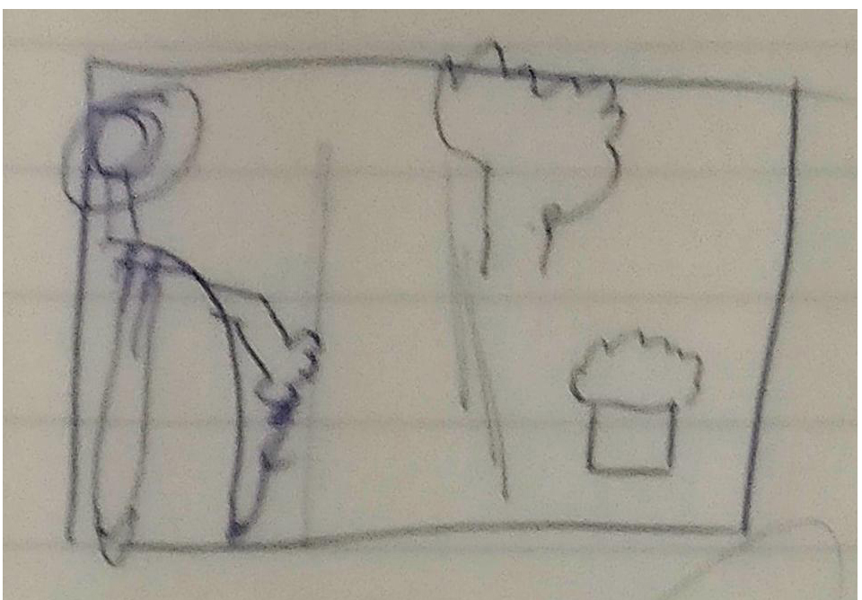
Image Sketch

Slide 5
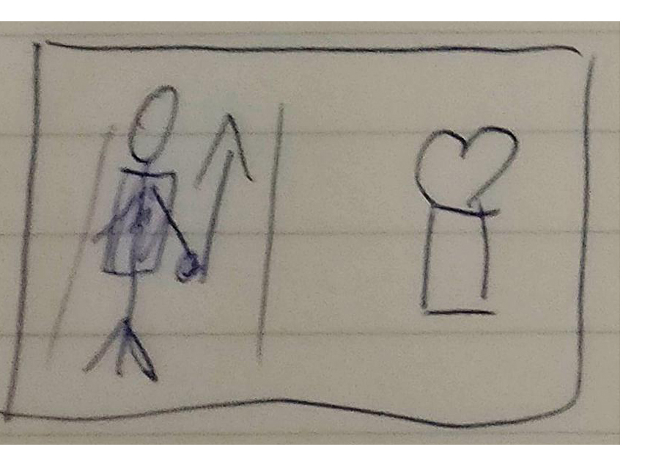
Image Sketch

Slide 6
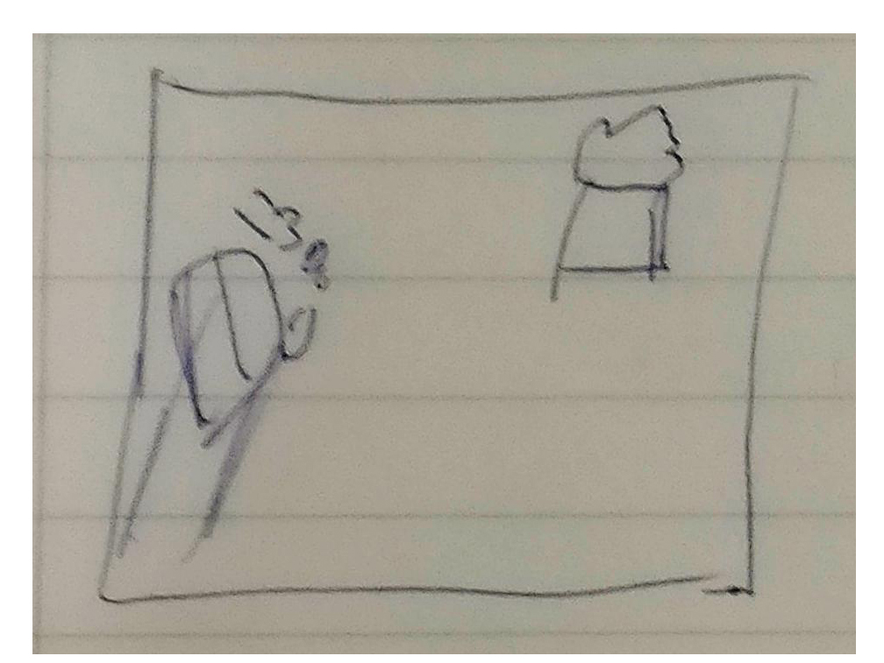
Image Sketch

Slide 7
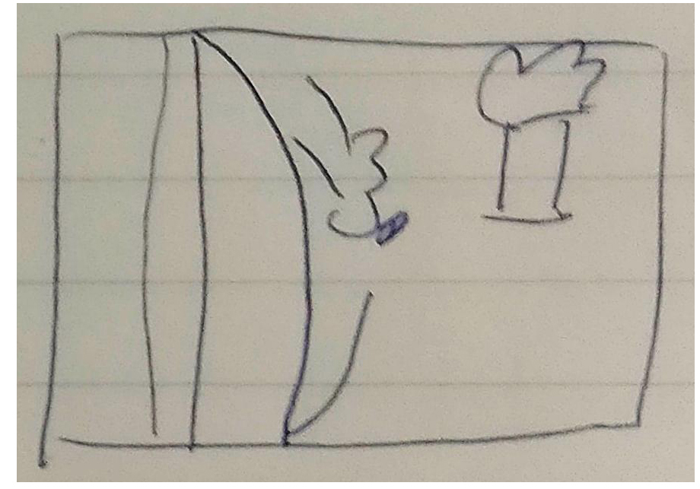
Image Sketch

Slide 8
Final outcome
Message to the Audience.
4 Photos
To get the message trough to the audience that we don’t stuff the trash cans but rather throwing it away later.

Slide 9
The End
Any Questions ?
Thankyou for your time

